Slide 1


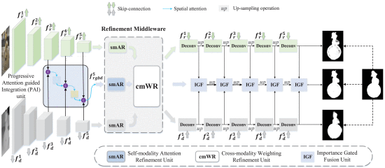




PURPOSE
PIPELINE
Underwater Salient Object Detection (USOD) faces several challenges that terrestrial models don’t expect. Wavelength dependent light attenuation, reduced contrast and blurred objects.
If a competent image enhancement method was used before training, inference or both, could a terrestrial SOD model compete with a USOD one?
USOD10K Image
WWPF Enhancement
ENHANCEMENT COMPARISON
CIRNet SOD Model Trained on WWPF
RAW
DehazeFormer
Best SOD Performance
WWPF
Best UCIQE Performance
Predicted Saliency Map
SOD PERFORMANCE COMPARISON
KEY RESULTS
< 0.3% DIFFERENCE
F-MAX between CIRNet on DehazeFormer Images and TC-USOD
0 CORRELATION
Between perceptual quality metrics and SOD performance
20% FASTER
TC-USOD inference on enhanced images
CONCLUSIONS
DehazeFormer, trained only on terrestrial haze, outperformed underwater-specific methods in SOD
Enhancement methods that have a strong effect on the image’s distribution only improve SOD when trained on the enhanced images. Otherwise they actively degrade performance.
Image quality metrics such as UCIQE and UIQM show no reliable correlation with downstream SOD performance
CIRNet retrained on underwater data with DehazeFormer came within 0.3% of TC-USOD on F-MAX. This means that CNN-based SOD models remain viable in certain applications.
Architecture remains the primary performance determinant, but preprocessing offers a practical lightweight improvement for deployment-constrained scenarios
DehazeFormer, trained only on terrestrial haze, outperformed underwater-specific methods in SOD
Enhancement methods that have a strong effect on the image’s distribution only improve SOD when trained on the enhanced images. Otherwise they actively degrade performance.
Image quality metrics such as UCIQE and UIQM show no reliable correlation with downstream SOD performance
CIRNet retrained on underwater data with DehazeFormer came within 0.3% of TC-USOD on F-MAX. This means that CNN-based SOD models remain viable in certain applications.
Architecture remains the primary performance determinant, but preprocessing offers a practical lightweight improvement for deployment-constrained scenarios

